Slide 1
Complete, telomere-to-telomere assembly of diploid human genomes and beyond
Sergey Koren
Biodiversity Genomics Academy
October 2nd, 2024

Slide 2

Telomere-to-Telomere
The human genome is finally finished!
8% was left after HGP
Solved with combination of HiFi + ultra-long ONT
The complete sequence of a human genome. Nurk, Koren, Rhie, Rautiainen, et al. Science (2022)

Slide 3
A new era of sequencing

Slide 4
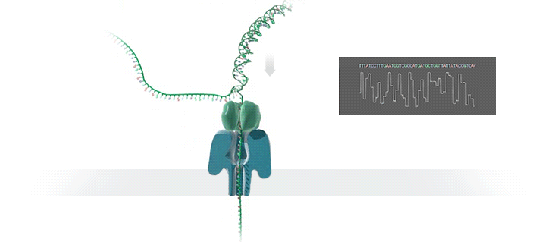
Nanopore ultra-long sequencing
Nanopore UL
>100 kb reads, up to 1 Mb
95% (Q13) read quality
99.9% (Q30+) assembly quality
Pros
Length and throughput
Reads span repeats
Cons
Lower base quality
Nanopore sequencing and assembly of a human genome with ultra-long reads. Jain et al. Nature Biotechnology (2018)
Nanopore sequencing and the Shasta toolkit enable efficient de novo assembly of eleven human genomes. Shafin et al. Nature Biotechnology (2020)

Slide 5
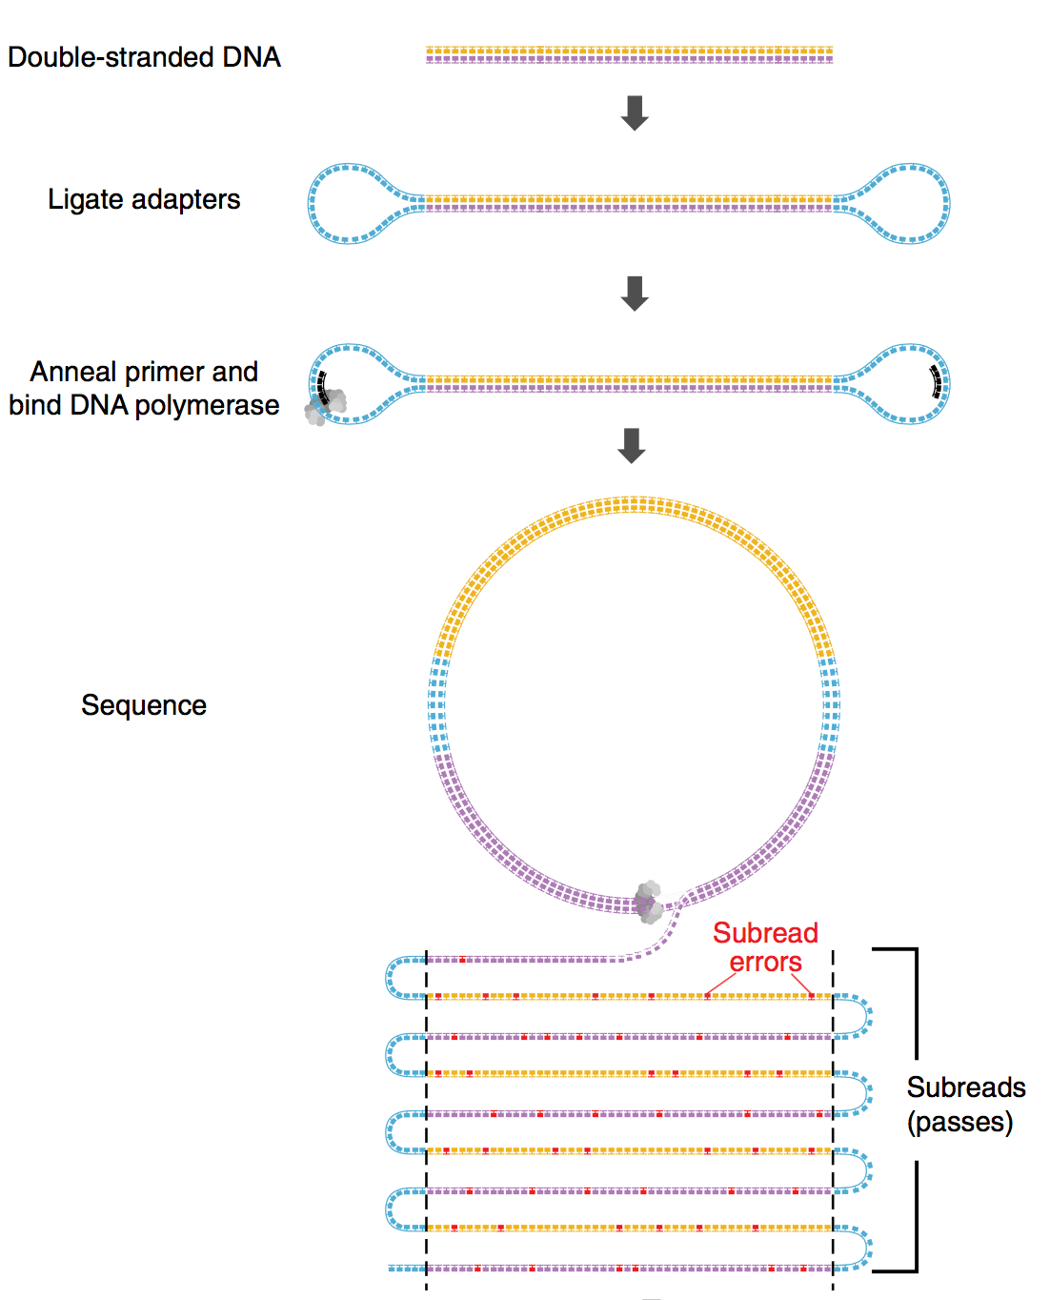
PacBio circular consensus sequencing
PacBio HiFi
20 kb reads
99.9% (Q30) read quality
99.9999% (Q60+) assembly quality
Pros
Near-perfect accuracy
Reads distinguish repeats
Cons
Limited length and coverage
Accurate circular consensus long-read sequencing improves variant detection and assembly of a human genome. Wenger et al. Nature Biotechnology (2019)
HiCanu: accurate assembly of segmental duplications, satellites, and allelic variants from high-fidelity long reads. Nurk et al. Genome Research (2020)

Slide 6
Two ways to resolve repeats: length
Nanopore UL read length distribution is long tailed
repeat
repeat

Slide 7
Two ways to resolve repeats: accuracy
HiFi reads are accurate
repeat
repeat

Slide 8
Best of both worlds

Slide 9
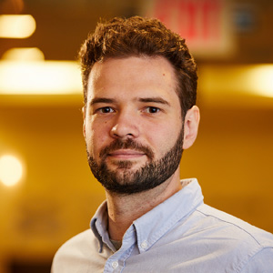
Integrating HiFi and ONT
HiFi accurate assembly graph
Homopolymer compression (CAAAAT → CAT)
Alignment-based read cleaning and correction
Assembly graph from long perfect overlaps
Nanopore long repeat resolution
Nanopore reads aligned to the graph
Correctly count, order, and orient the repeats
HiFi-based consensus minimizes error-prone polishing
The complete sequence of a human genome. Nurk, Koren, Rhie, Rautiainen, et al. Science (2022)

Slide 10
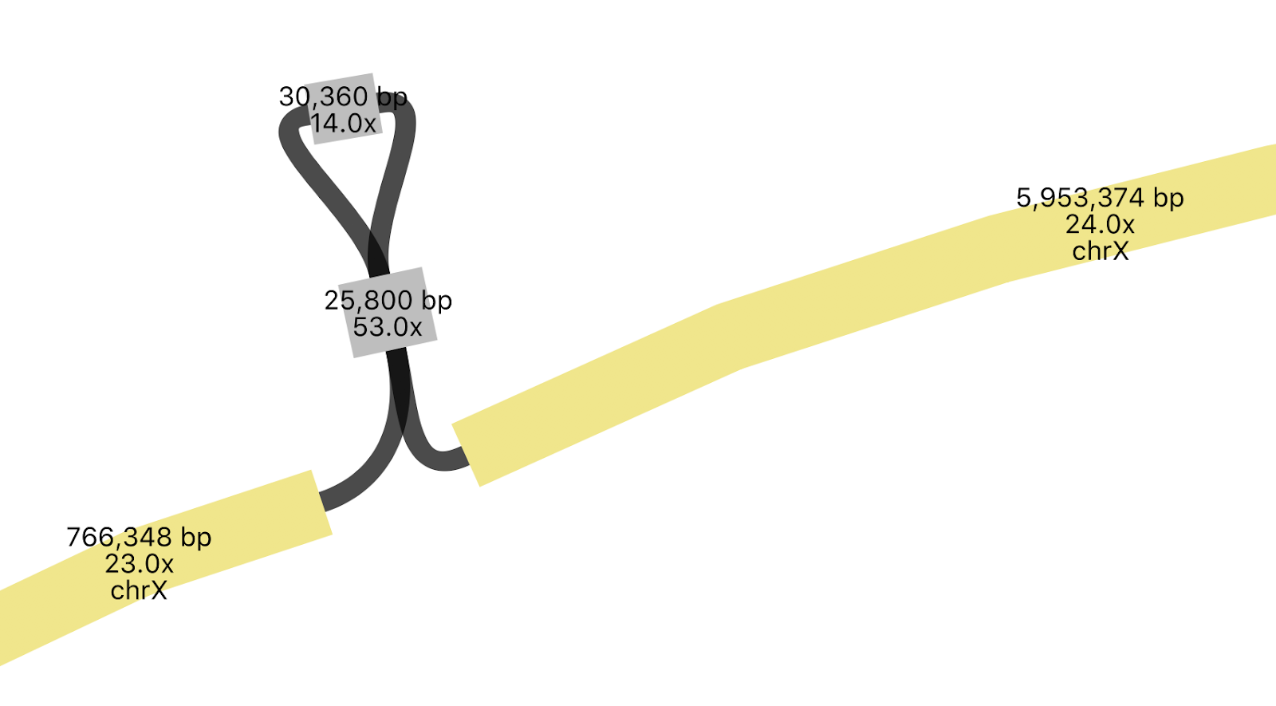
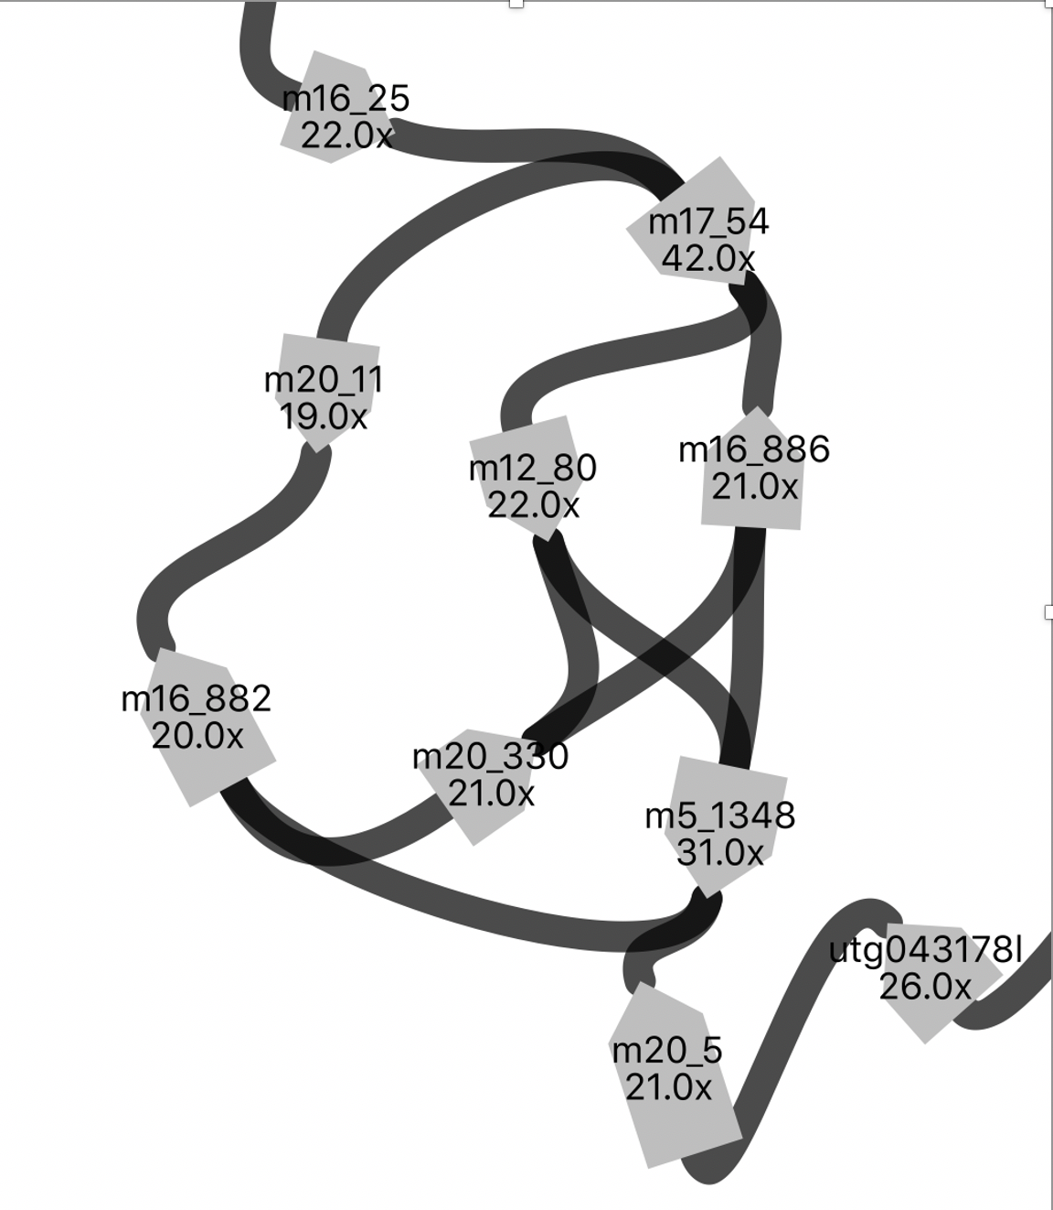
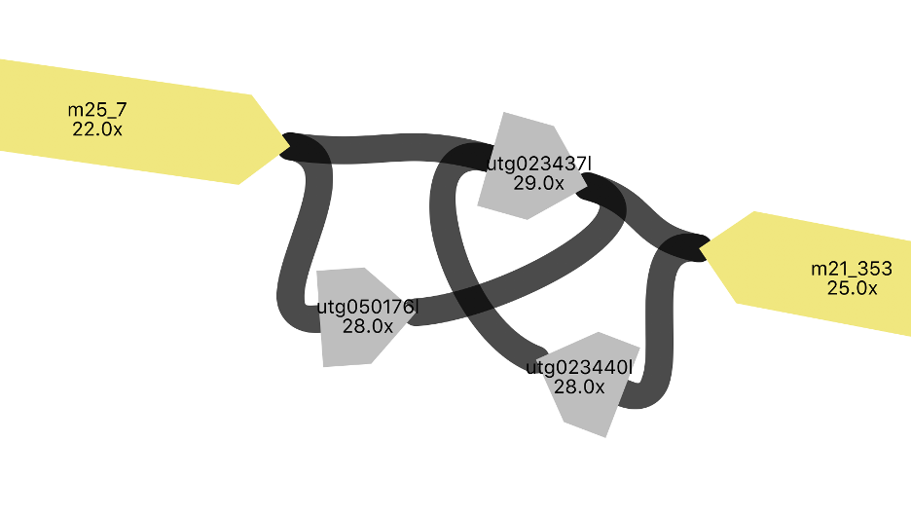

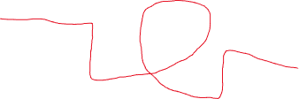
Simplifying the HiFi graph
Walking simple paths
Aligning Nanopore reads
1
2/7
6
8
3
5
4
9
11
10

Slide 11
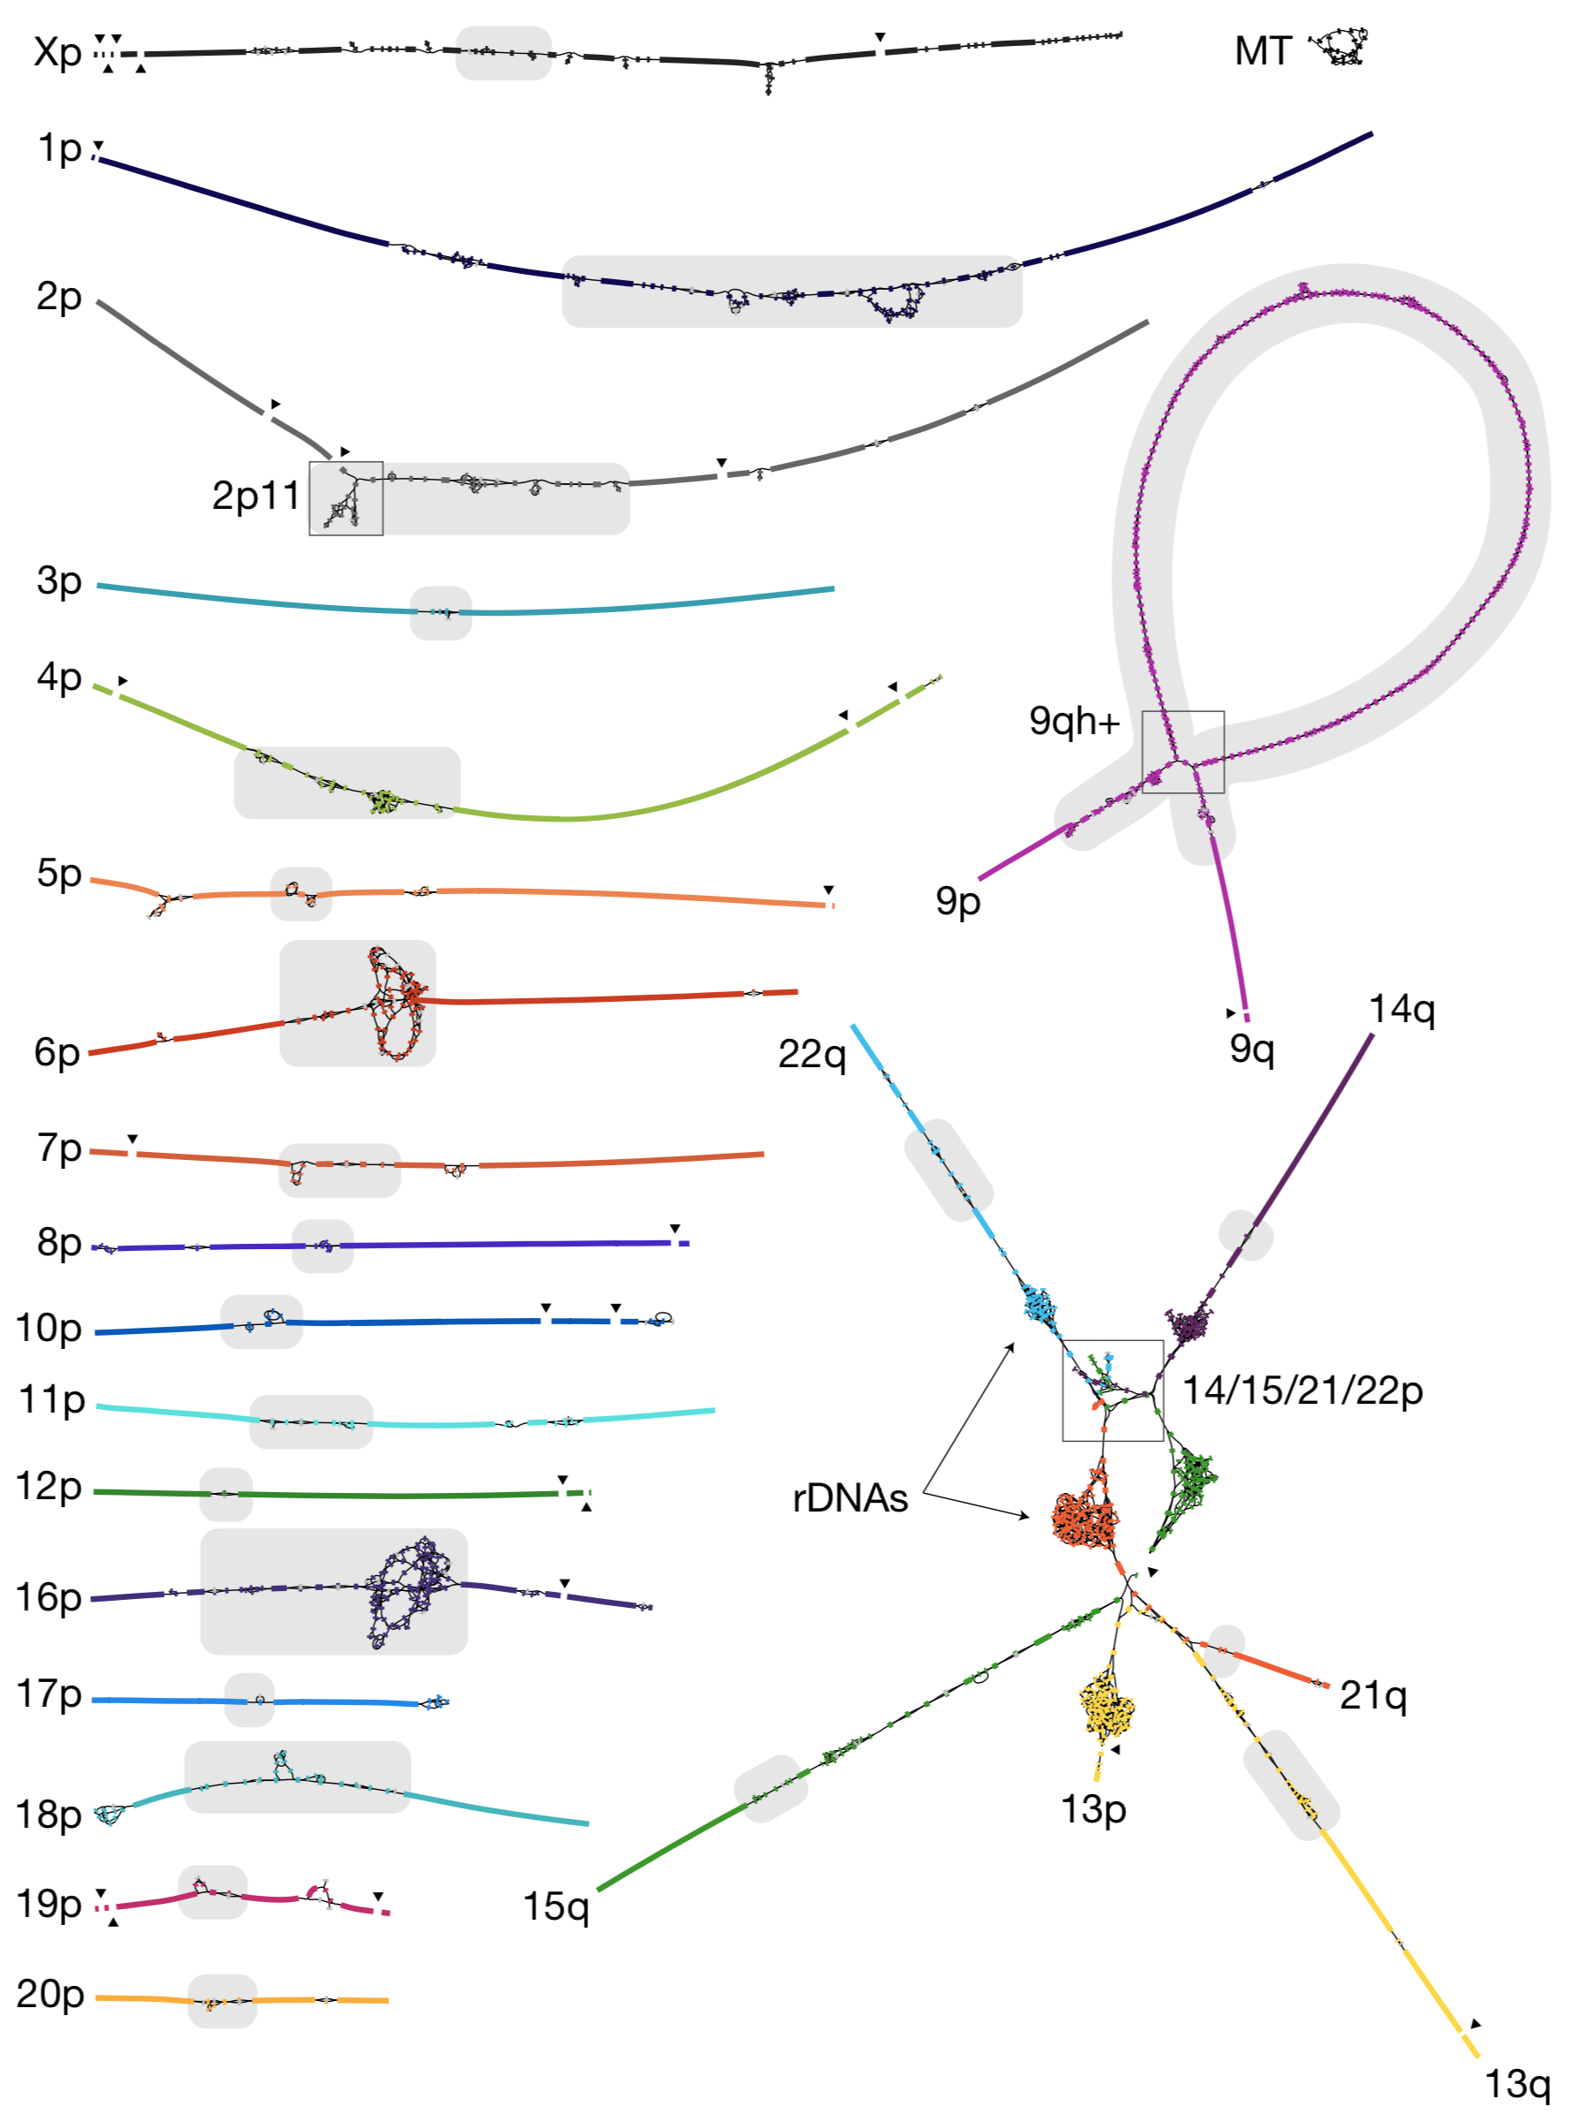
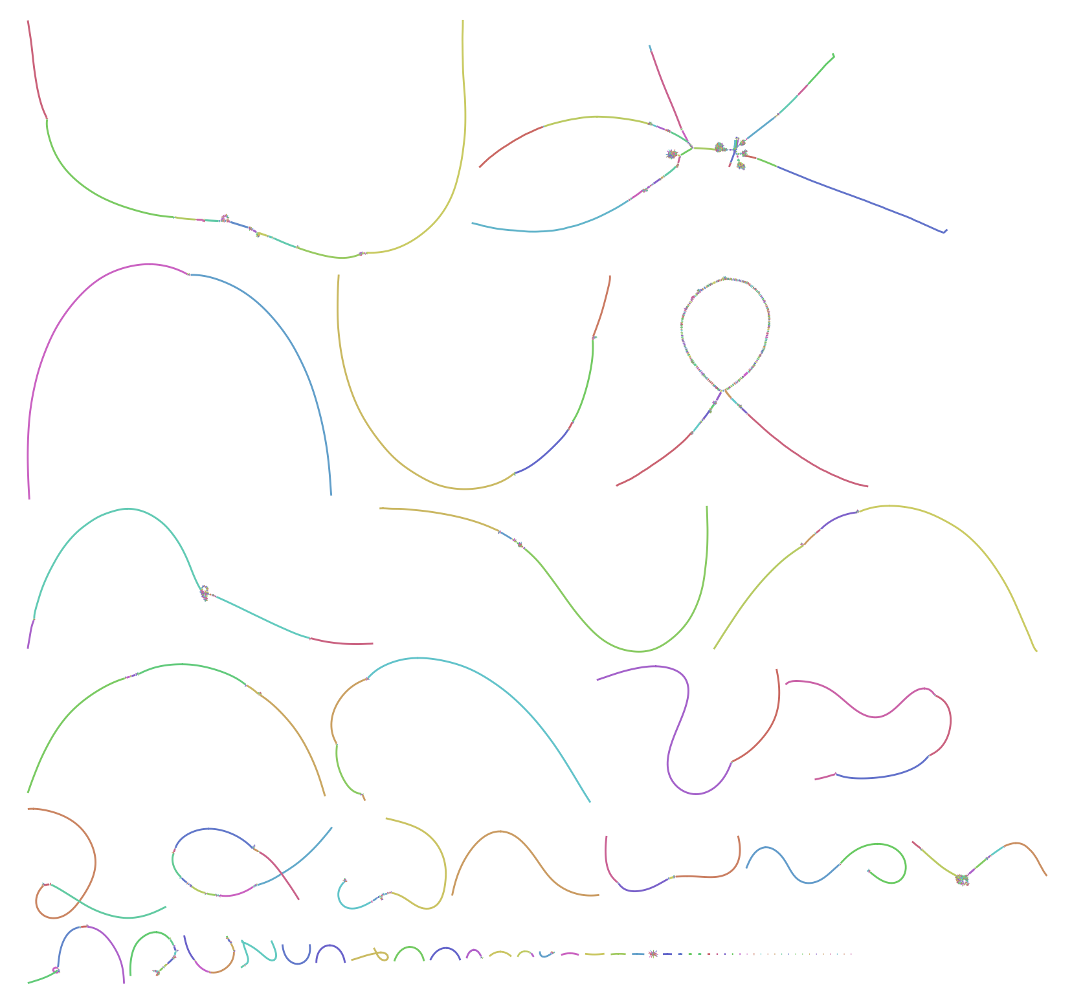
Manual analysis is time consuming

Slide 12
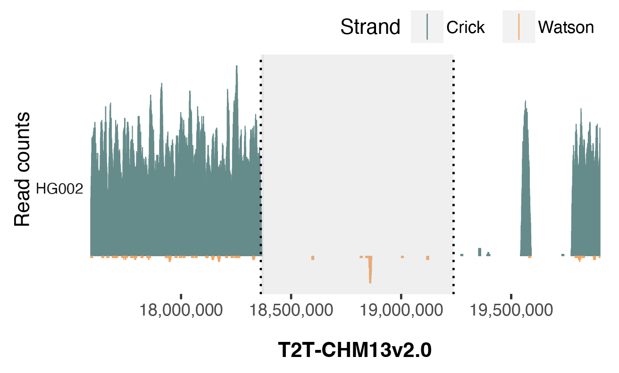
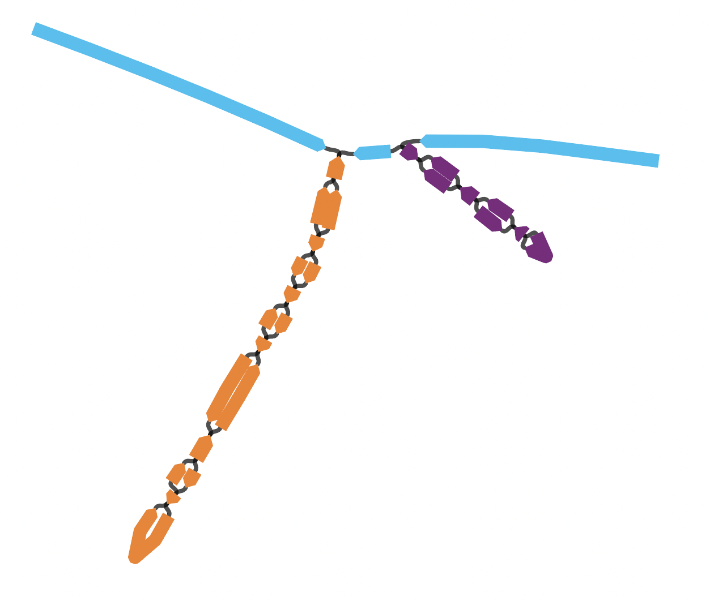
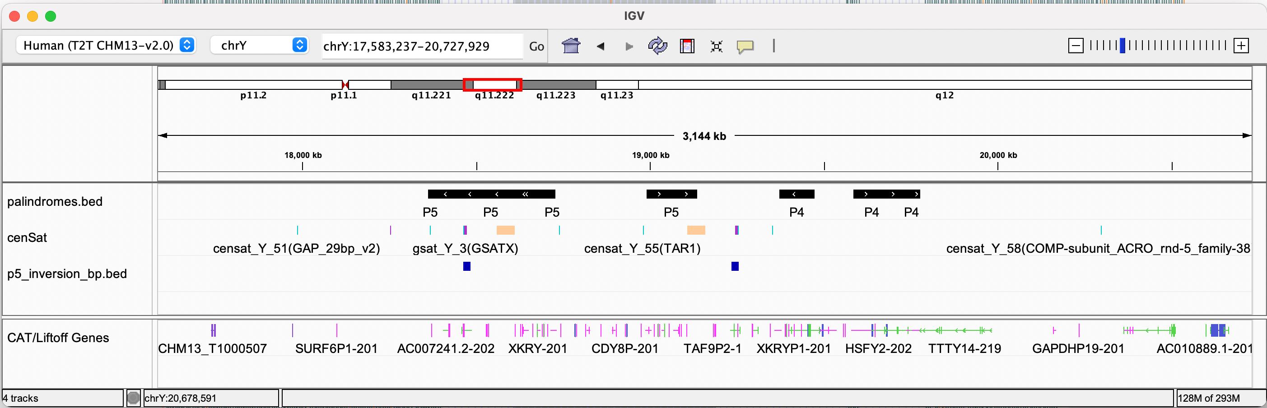
…and error prone
P5
P4
P5 mis-assembly (~800 kb)
~20 kbp 100% identical
Notes:
chrY:17,583,237-20,727,929

Slide 13
Can we automate this?

Slide 14
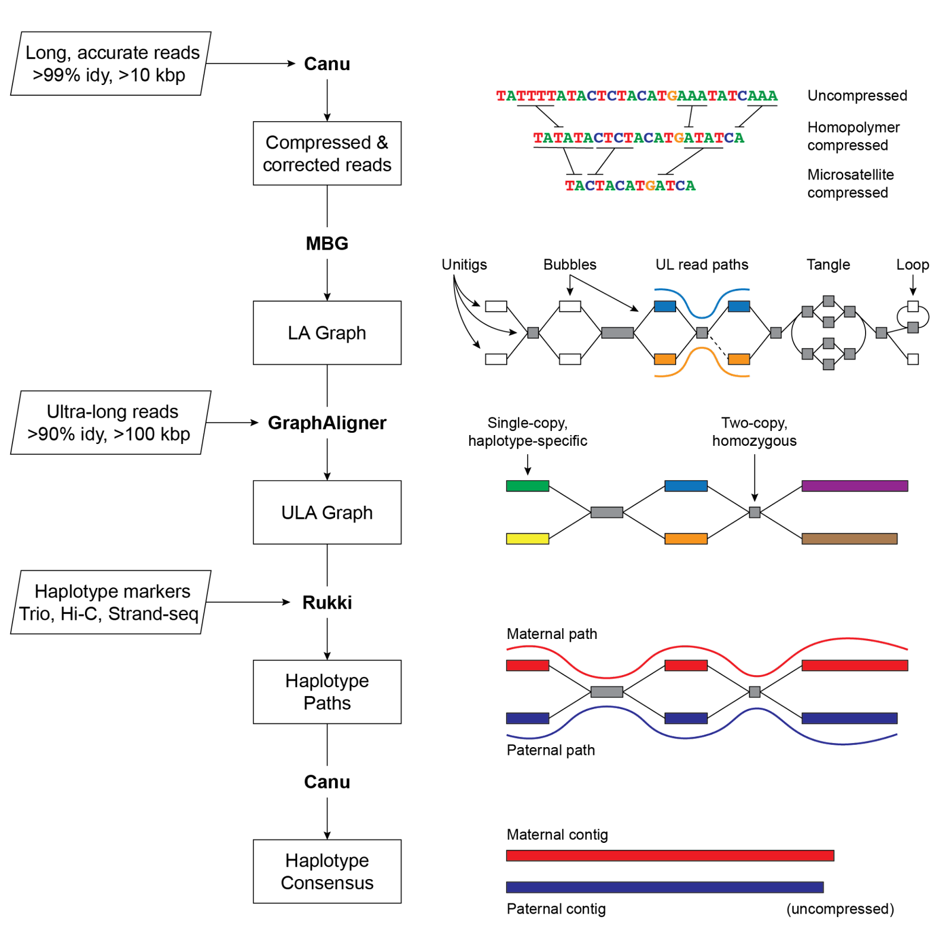
Verkko!
Sequencing recipe (per hap)
20-25x high accuracy
(Pac Bio HiFi, Duplex, HERRO)
15-20x ONT ultra-long (>100 kb)
20x Illumina Trio or Hi-C
Available from conda
Verkko pipeline
Read correction
Sparse multiplex DBG
ONT graph simplification
Walk haplotypes
Haplotype consensus
Verkko: telomere-to-telomere assembly of diploid chromosomes
Rautiainen, et al. bioRxiv (2022)
LJA: Assembling Long and Accurate Reads Using Multiplex de Bruijn Graphs
Bankevich, et al. Nat Biotech (2021)

Slide 15
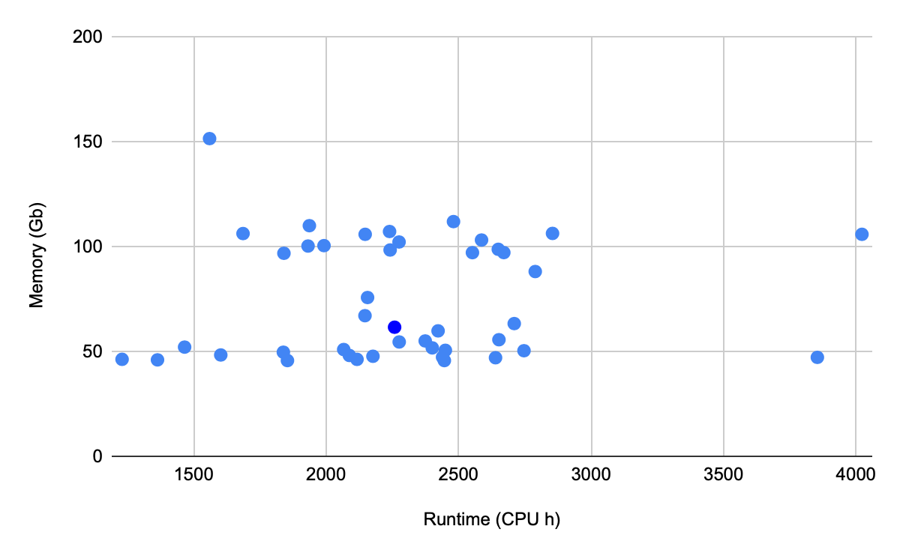
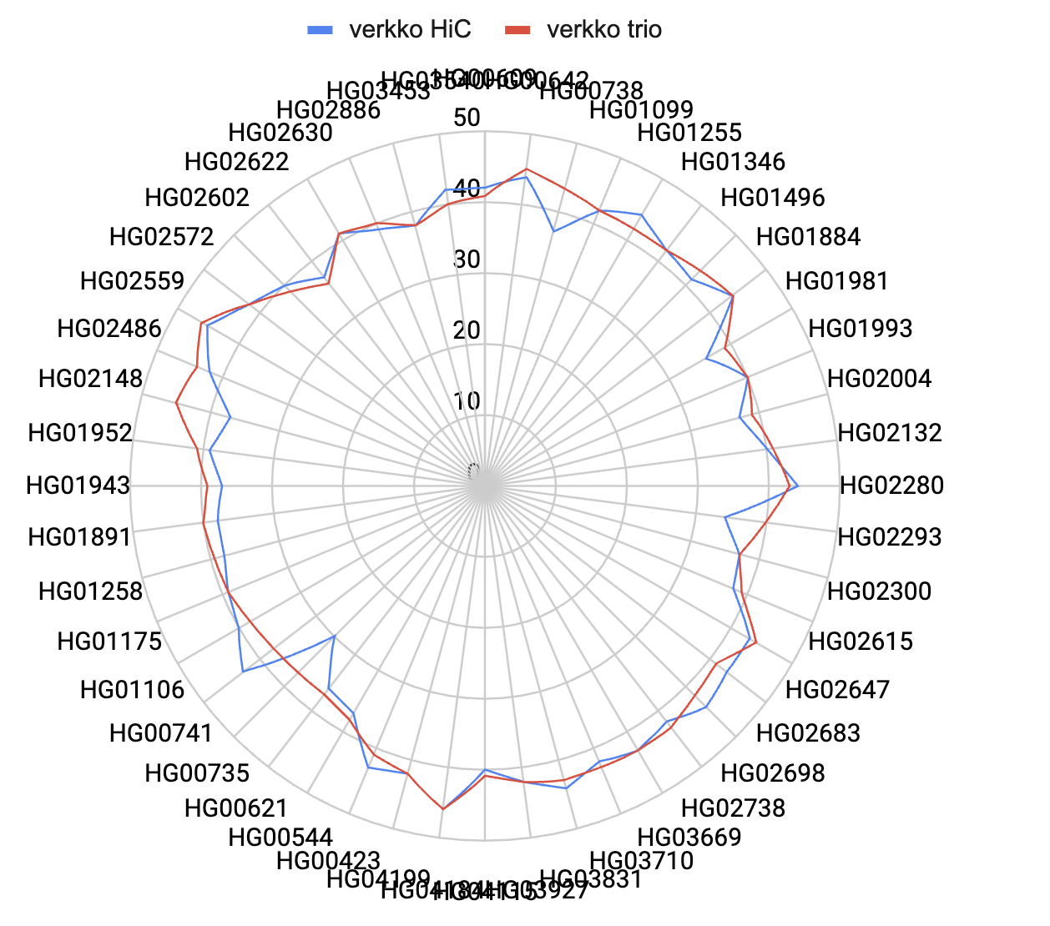
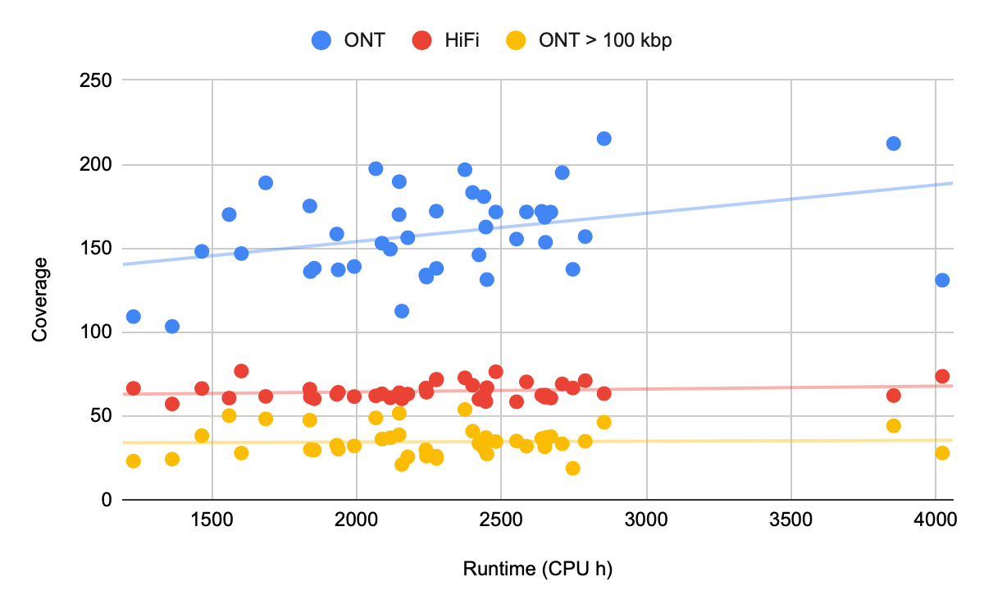
State of the assembly, Sept 2024
Our assemblies are strong, 40/46 T2T scaffold average on 101 human samples
62x HiFi, 34x >100 kbp ONT (158x total), 68x Hi-C
verkko Hi-C
verkko trio + Hi-C

Slide 16
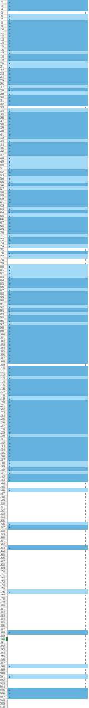
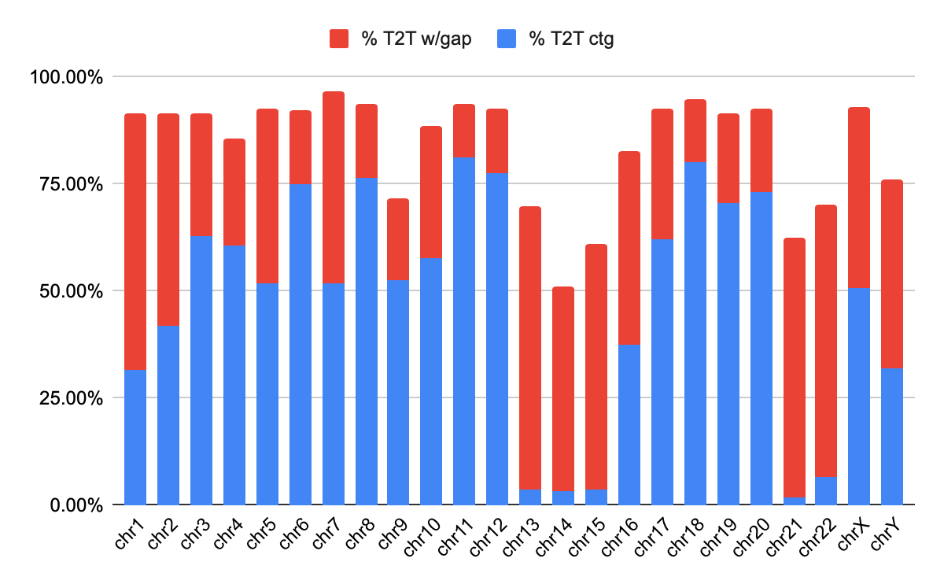
State of the assembly, Sept 2024
Another view, by chromosome, 52% T2T contig, 91% T2T scaffold
Acrocentrics
Unexpected
Switch to Revio 24hr movie (30hr is OK)
verkko Hi-C

Slide 17
How do we know it’s any good?

Slide 18
T2T QC
some near-telomere sequence scaffolded
T2T contigs and scaffolds
QV
Merqury, yak
Hamming & switch error rate
If trio data available
Missing/duplicated core genes
Compleasm, busco
non-T2T contiguity metrics
N50, L50
Alignment-based evaluation
NucFreq, Flagger, VerityMap
Huge gap!
telomeres
Contigs from the middle of the chromosome
None of the metrics on the left helps to see that something is not right here!
Notes:
Malevolent genome assembler developer can fake all those metrics!

Slide 19
QC: Not only summary metrics!
Typically include detailed locations of problematic regions
yak trioeval: which contig has most switch errors? Are there lots of “small” switches causing hamming error or one big one?
compleasm: on which chromosome are the missing genes? On which scaffold are the duplicated genes?
With verkko-generated assembly.scfmap and assembly.paths.tsv you can locate those problematic places in graph and sometimes see something interesting
Notes:
Before the slide with hairpin

Slide 20
Genome graphs are our friends

Slide 21
Graph, the “Good, the meh and the ugly”
Q20 Herro-correct, ≅300 nodes
- 44 T2T scfs (36 ctgs)
Large nodes, little gray (hom) or yellow (switch)
Telomeres visible in all components (4 in diploid/2 in haploid)
No hanging edges, all nodes have neighbors or go to telomere
Clear rDNA tangle (species specific)

Slide 22
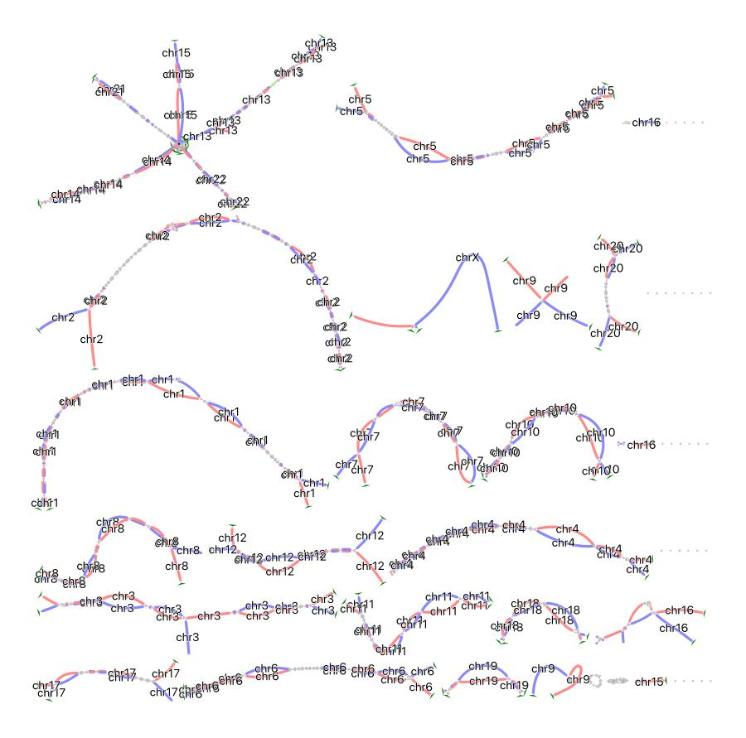
Graph, the “Good, the meh and the ugly”
Revio/R10 YR4, ≅900 nodes
- 37 T2T scfs (25 ctgs)
Shorter nodes, more gray (hom) or yellow (switch)
Telomeres missing when expected
Hanging edges, missing connection in one or both haplotypes

Slide 23
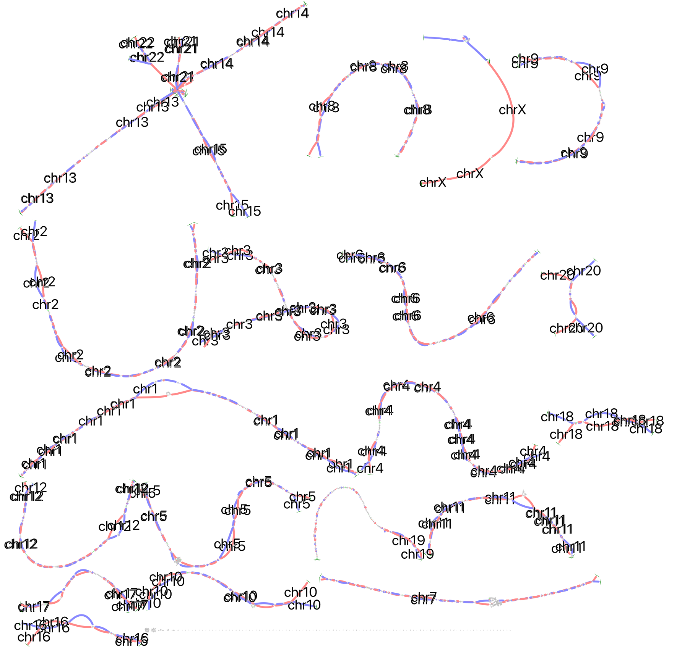
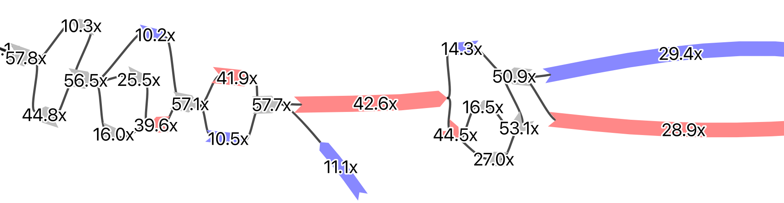
Graph, the “Good, the meh and the ugly”
Sequel II, R9 ≅2000 nodes
- 40 T2T scfs (31 ctgs)
Shorter nodes, more gray (hom) or yellow (switch)
Non-diploid structure, cell line issue?

Slide 24
What can go wrong?

Slide 25
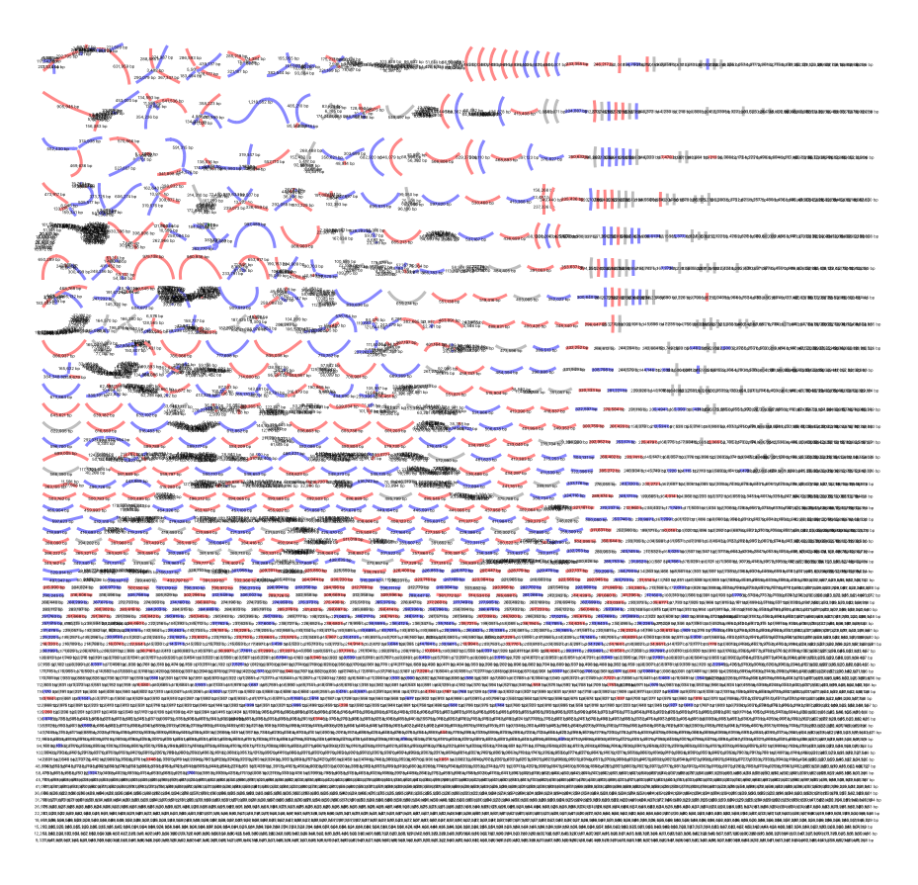

Too few T2T, fragmented assembly
On the left: either ONT problem (too short) or just the genome structure
On the right: HiFi ultra-low input protocol problems

Slide 26
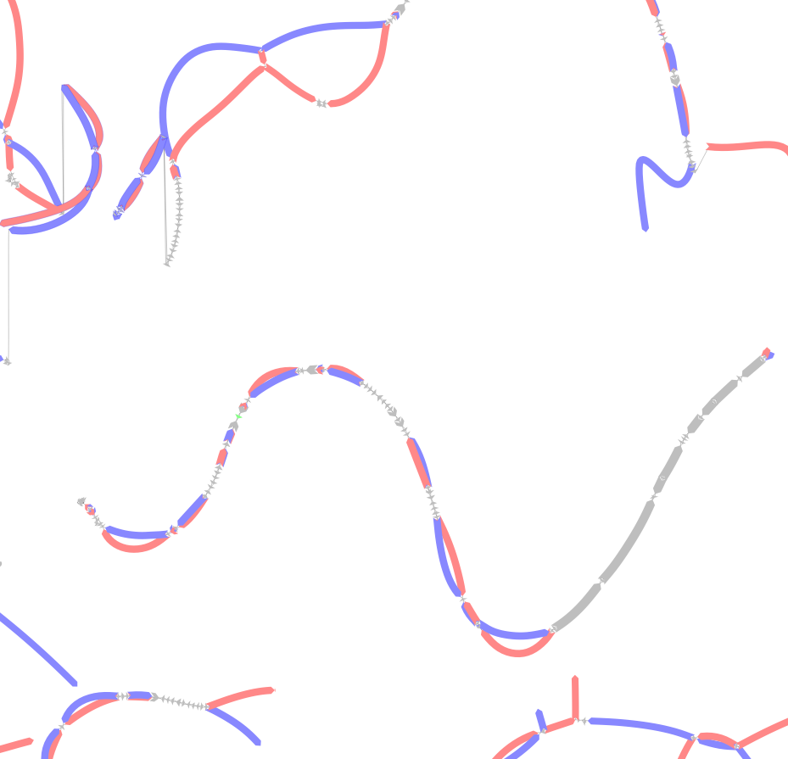
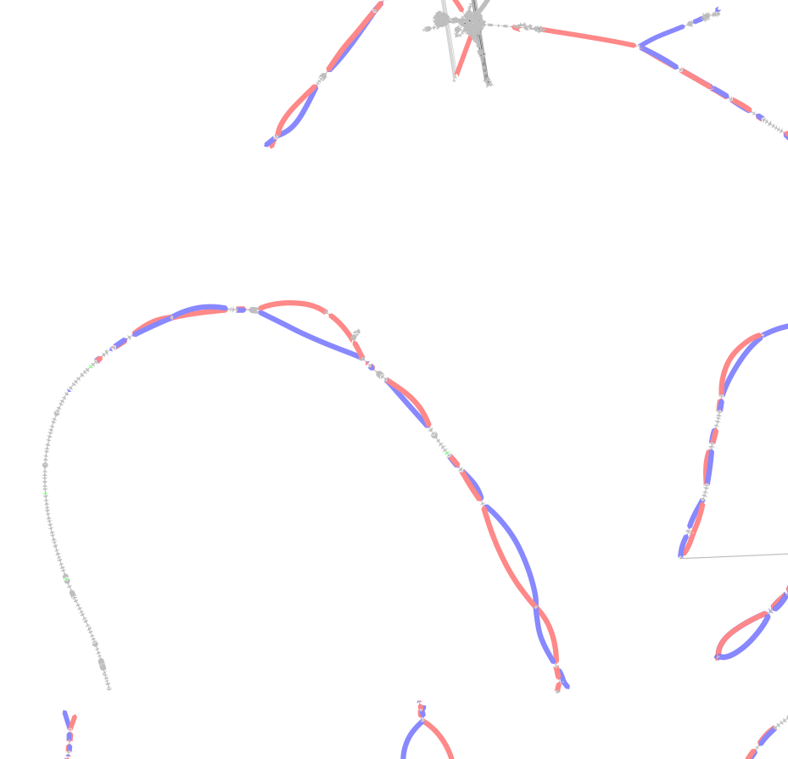
Phasing issues: large homozygous regions
Different chromosomes of same bonobo sample
Left is phased correctly (long nodes ), right - lots of unassigned (and so missing genes)
Notes:
HG002 old assembly

Slide 27
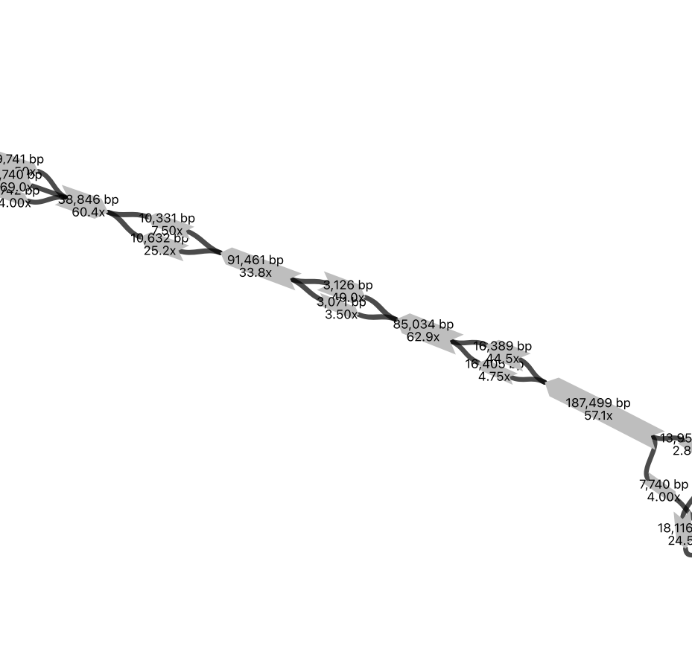
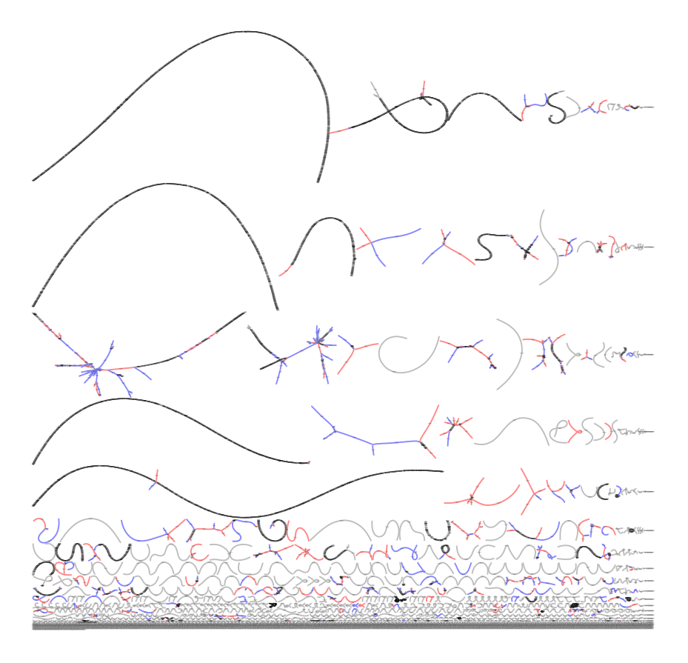
Heterozygosity level matters!
Verkko can have problems with both very high and very low heterozygosity
Sometimes this may even happen in the same sample!

Slide 28
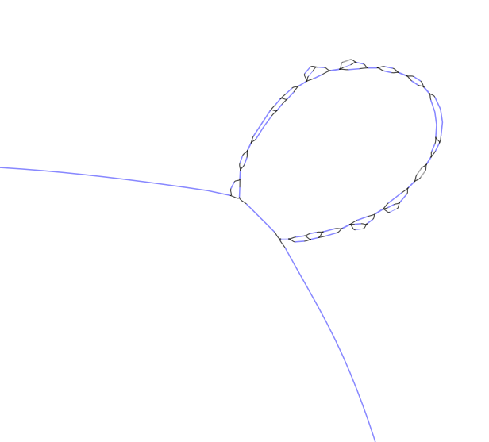
Large tandem repeats
Large (few Mb) tandem repeats is quite typical issue preventing verkko from T2T.
Verkko/rukki heuristics stops because there are multiple large “blue” extensions for a large blue node here.
Usually random walk will not add many errors here

Slide 29
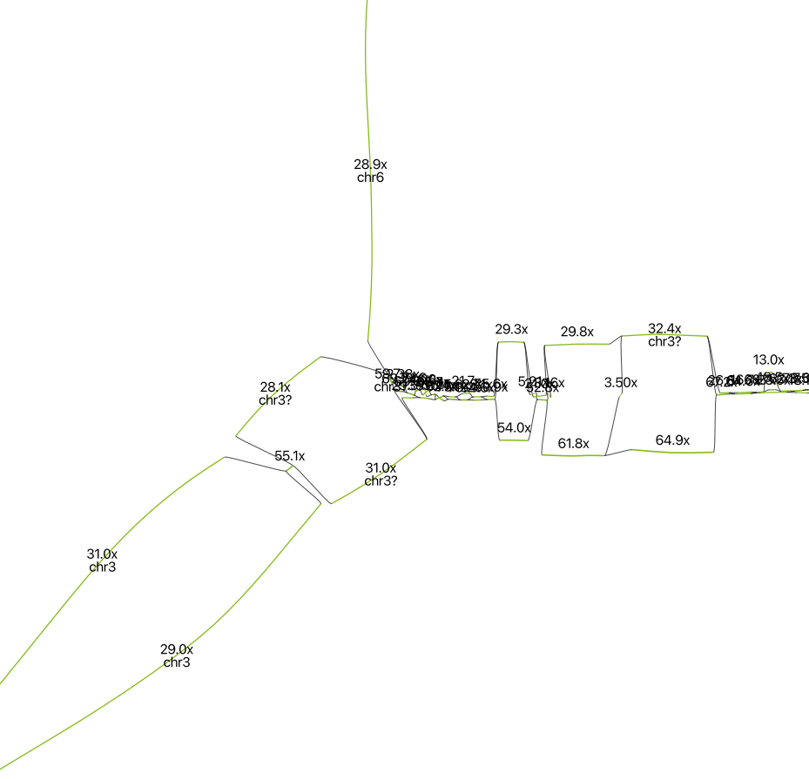
“Biological” conclusions from graphs
Part of chr6 on one of the haplotypes is partially replaced with chr3!
Coverage confirms “triploidy” for half of chr3
Still can be a cell line issue

Slide 30
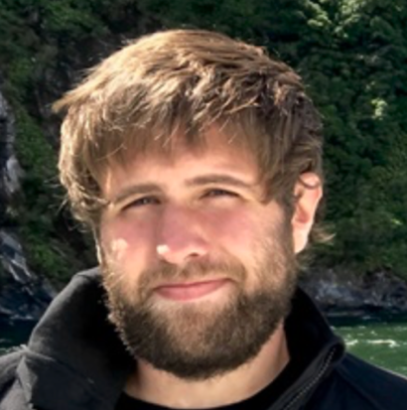


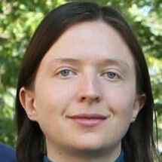
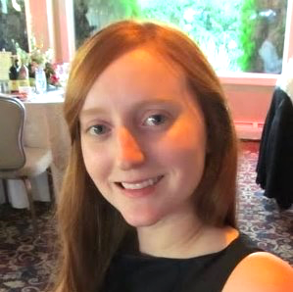


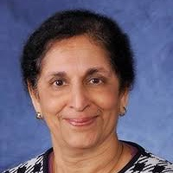
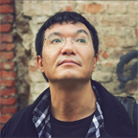

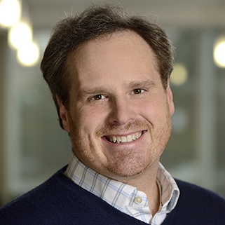
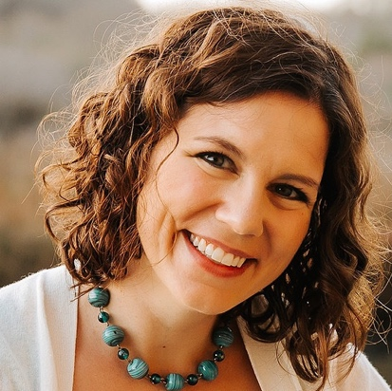


Team T2T (…and many more)

